Slide 1
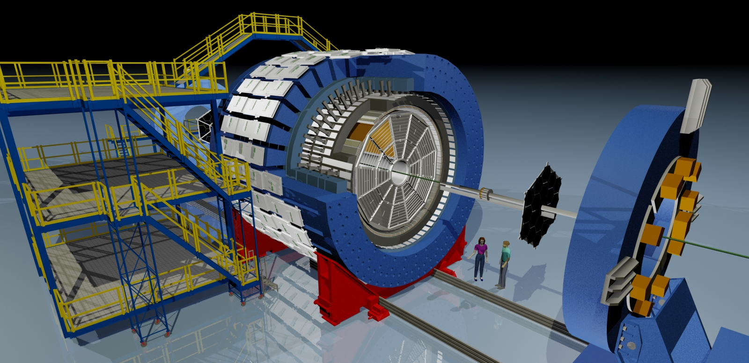
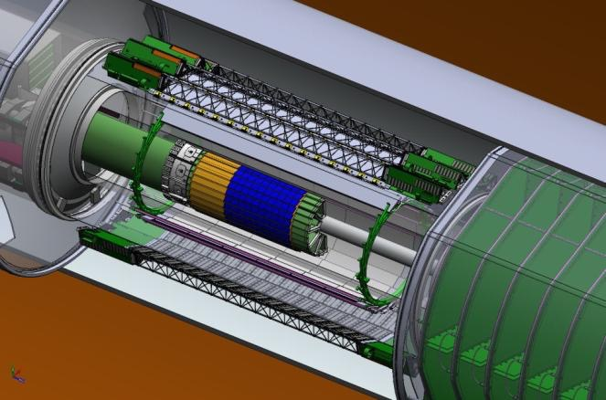
EEMC
MTD
BEMC
TPC
TOF
VPD
BBC
HFT

Slide 2
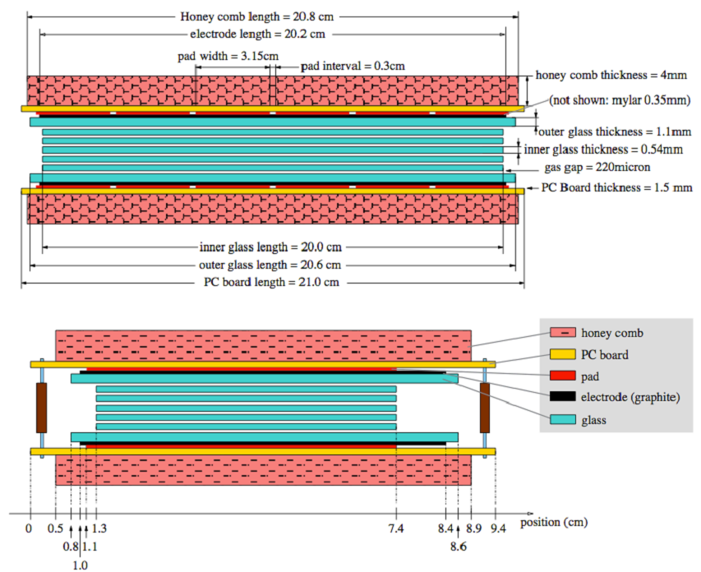

Slide 3
MTRG
Online
MRPC
MFTB
MINO
TDIG
TCPU
THUB
Offline

Slide 4
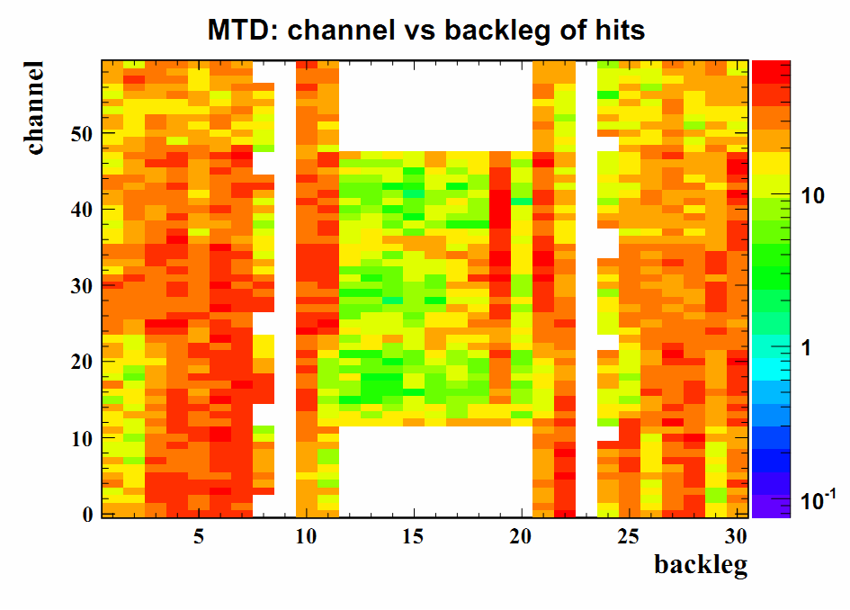

Slide 5
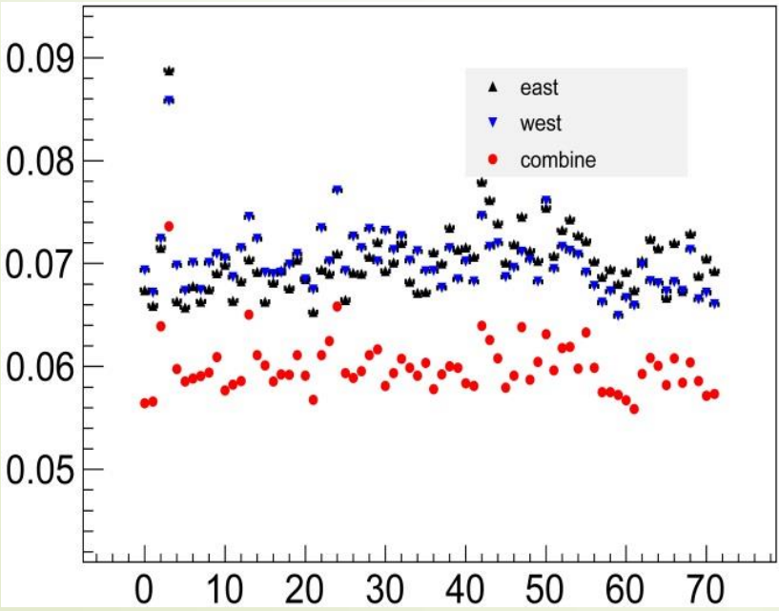
Resolution (ns)
Module ID

